Slide 1


Take back your time! Let AI do the work for you
Eldert Grootenboer

Slide 2


Eldert Grootenboer
@egrootenboer

Slide 3
Take back your time!
Time is precious
Wasted on repetitive tasks
Less time for innovation

Slide 4
Let AI do the work for you
Gartner predicts 69% of routine work currently done by managers will be fully automated by 2024

Slide 5
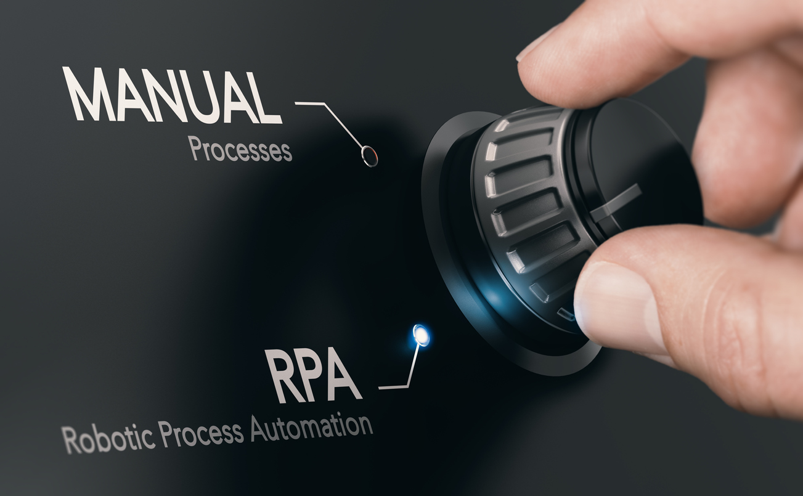
RPA

Slide 6
Introducing RPA
Robotic Process Automation
Virtual workers replicate human actions
Perform repetitive rule-based work
Aide or replace human interaction

Slide 7
Use cases
Legacy applications
Data entry
System to system

Slide 8
Advantages
Less boring repetitive tasks
Higher productivity
Less human errors
24/7 virtual workforce
Cost reduction
Scalability

Slide 9

Microsoft Power Platform

Slide 10

The various services

Slide 11
Empower your organization
No code, low code
Get started easily
Citizen developers

Slide 12
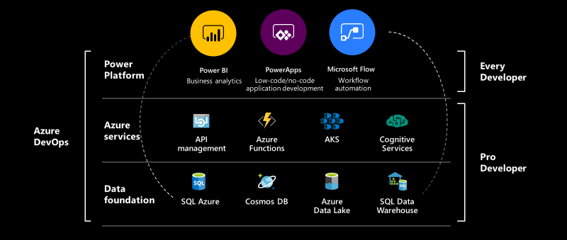
The bigger picture

Slide 13
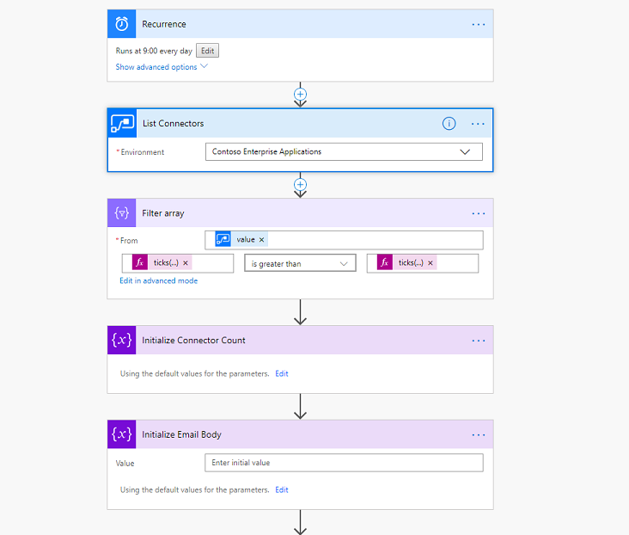
Power Automate

Slide 14
Multistep workflows
450+ connectors
Approvals and conditions
RPA capabilities
On-premises connectivity

Slide 15
RPA with Desktop flows
Windows and web applications
Record user interface actions
Test the recording
Play back and monitor
Free with Windows 10

Slide 16
Power Automate Desktop
Low-code development environment
Parallel execution and multi-tasking
Integrated with Power Automate cloud service
Exception handling to enable automation of complex cases

Slide 17

Demo
Timesheet automation
Notes:
Start from scratch in Power Automate
Explain scenario
Introduce Power Automate Desktop
Record steps entering data in TimeChimp
Use variables for entries
Add close browser window action

Slide 18

Personalize and extend

Slide 19
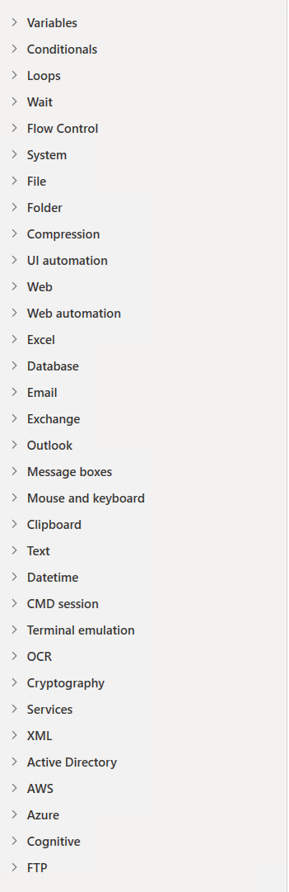
Advanced development
Loops, conditions and temporal control
Interact with applications, operating system and services
Simulate user actions in web or Windows
Use system and user inputs and outputs

Slide 20
Retrieve and write data
Communicate with filesystem
Send emails using Outlook
Exchange data with Excel

Slide 21

Demo
Customize with advanced features
Notes:
Power Automate Desktop only - Take back your time; Let AI do the work for you! - Demo 2
Create UI elements
Show capabilities about data retrieval, looping, UI interaction, etc.
Get data from Excel
Fill in TimeChimp using local experience with data from Excel

Slide 22
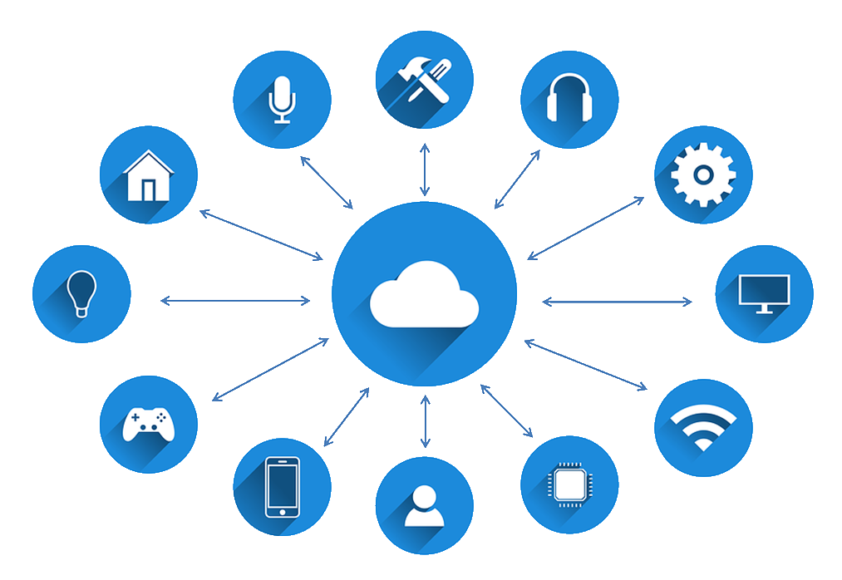
Power Automate integration

Slide 23
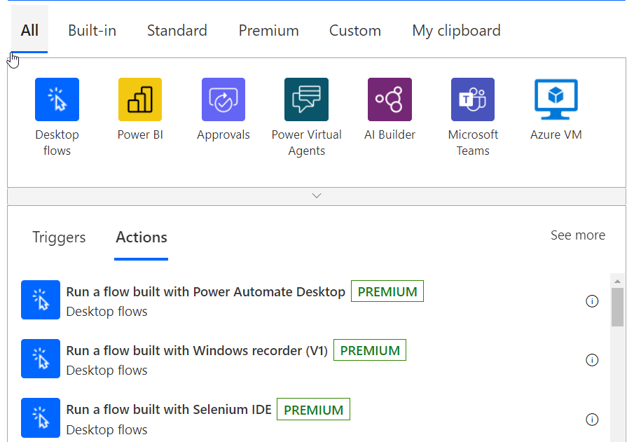
Run Desktop flows

Slide 24
Attended and unattended RPA
Attended
Unattended
Interactive automation
Background automation
Automate manual, individual tasks across
Automation of high-volume and tedious tasks
Overview
desktop and web
without lifting a finger
Scenario
On
-
demand task automation
Automate company processes at scale
Automation specialist
in
a
Audience
Citizen developer in business unit
Center of Excellence dedicated to RPA
Jobs on dedicated machines/robots do
Requirement
User signed in on their device/human initiated
the work

Slide 25
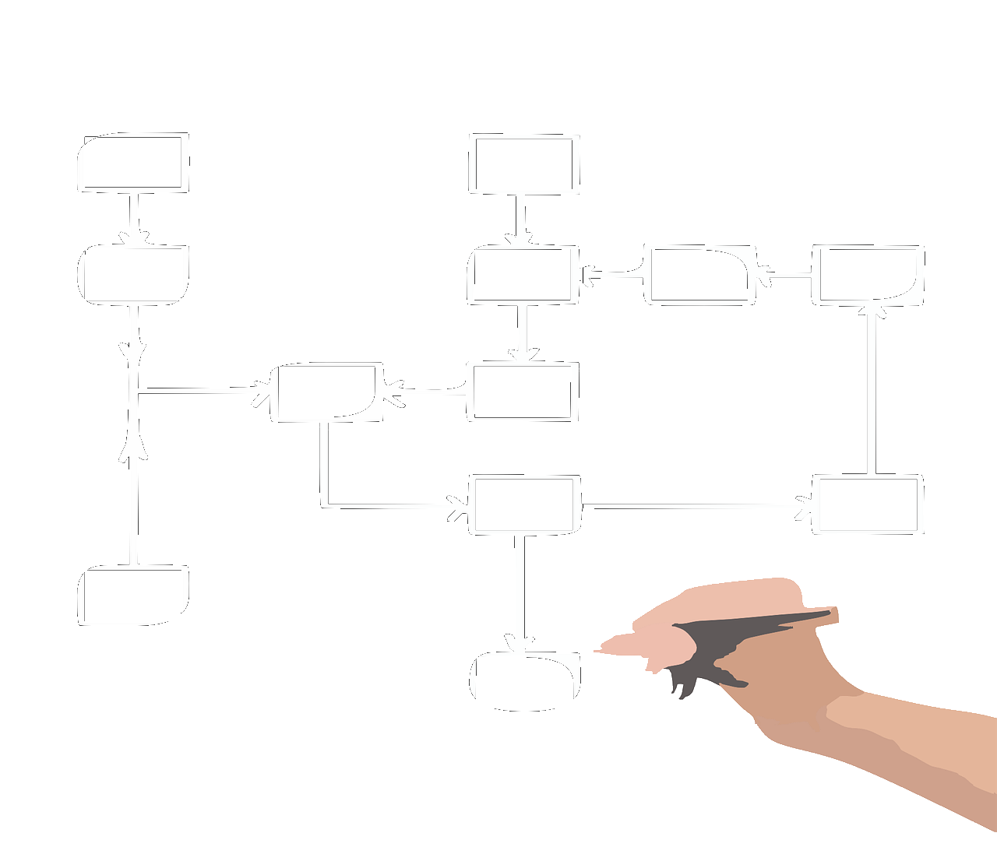
Demo
More control with Power Automate
Notes:
Power Automate - Take back your time; Let AI do the work for you! - Demo 3
Power Automate Desktop - Take back your time; Let AI do the work for you! - Demo 3
Use Power Automate to retrieve entries from Outlook
Call Power Automate Desktop for 3 customers
Fill in data for Contoso, Fabrikam and Northwind in TimeChimp (Website)
Fill in data for Fabrikam in Time Tracker (Windows application)
Fill in data for Northwind in Excel and send mail from Power Automate Desktop (Show Excel and Outlook capabilities and other possibilities)

Slide 26
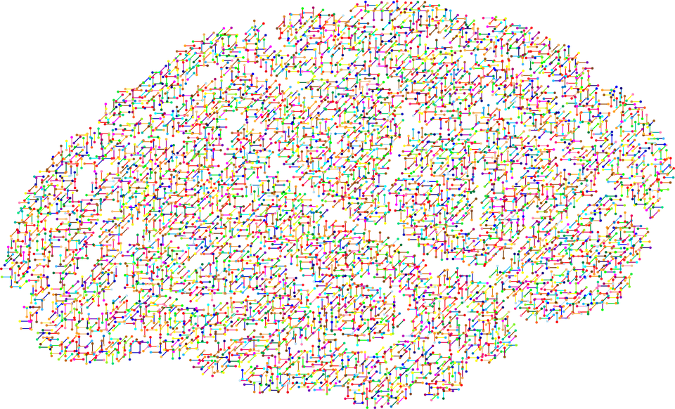
Smarter solutions with AI

Slide 27
Power Virtual Agents
Conversational bots
Create flows
Integrated
Various channels

Slide 28
AI Builder
Low code AI solutions
Business Card Scanner
Key Phrase Extraction
Language Detection
Text Recognition
Sentiment Analysis

Slide 29
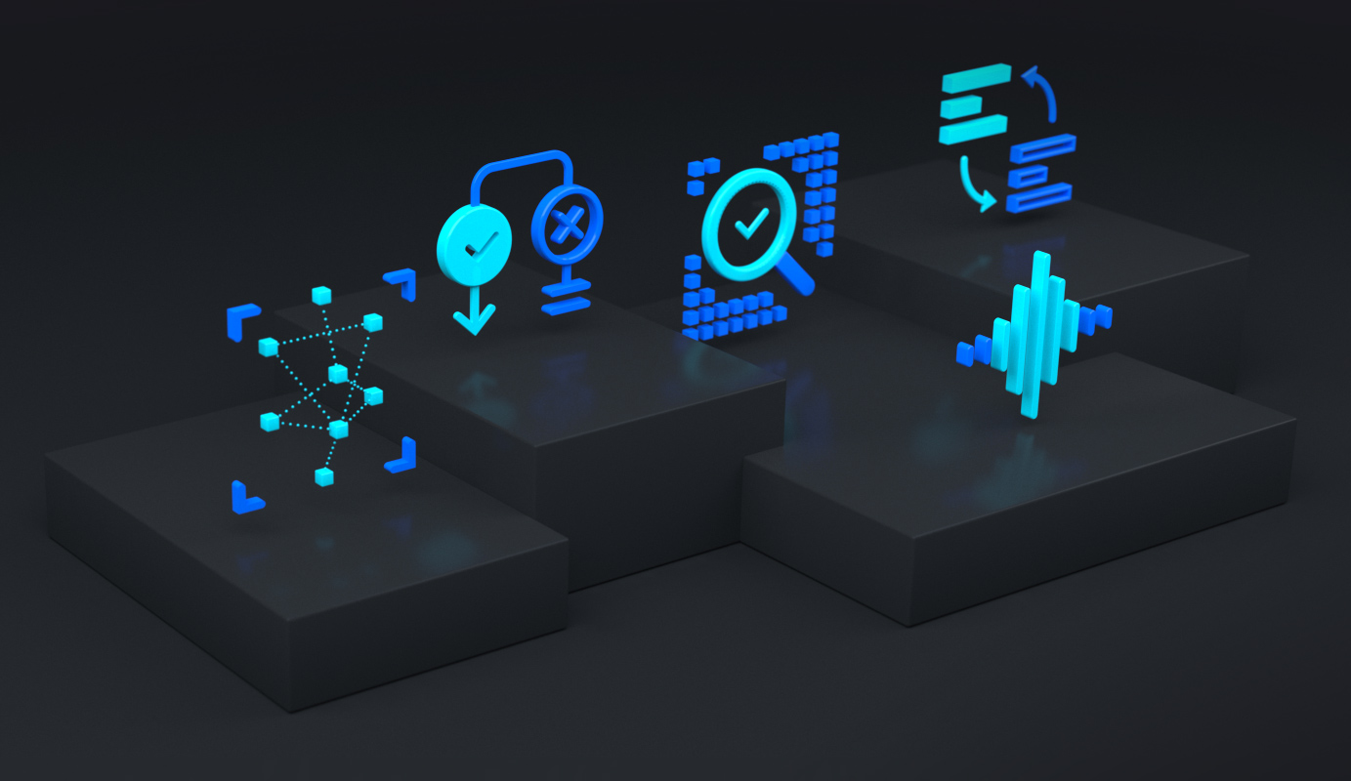
More power, more control
Azure Cognitive Services

Slide 30
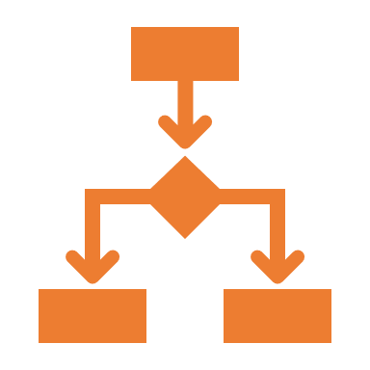




Azure Cognitive Services
Decision
Language
Speech
Vision
Web search
Notes:
Logical decision making
Natural language
Spoken language
Everything we see
Search and lookup
Cognitive Services bring AI within reach of every developer—without requiring machine-learning expertise. All it takes is an API call to embed the ability to see, hear, speak, search, understand, and accelerate decision-making into your apps.

Slide 31

Demo
Let AI help you
Notes:
Power Virtual Agent – Timesheets
Power Automate (open via PVA) - PVA - Take back your time; Let AI do the work for you! - Demo 4
Power Automate Desktop - Take back your time; Let AI do the work for you! - Demo 4
Triggered from Virtual Agent - Please give me my timesheet
Call Power Automate Desktop
Export TimeChimp overviews to OneDrive per customer
Wait for files to arrive on OneDrive
Send both files using email with approval
Receive response from Contoso
Use cognitive services to check for signature set (using Logic Apps?)
If signature not set, notify user
If signature set, save to SharePoint and notify user

Slide 32
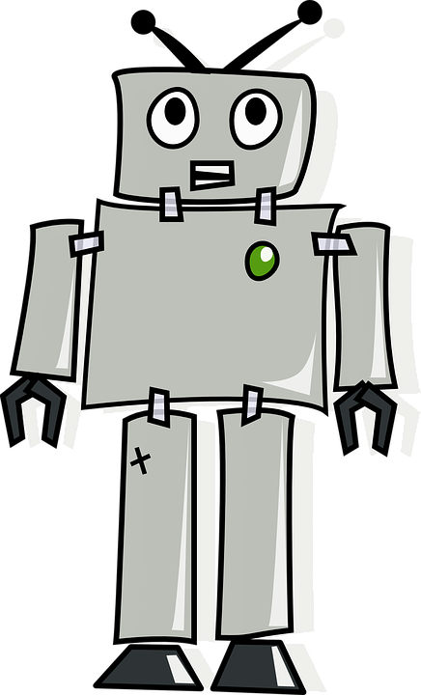
Almost done

Slide 33
Take aways
Automate
Automate repetitive tasks
Easy
Very low-entry to do complex work
Integrate
Combine the various services
Extend
Bring in more power using Azure

Slide 34



Thank You!
@egrootenboer
eldert@eldert.net
https://www.linkedin.com/in/eldert-grootenboer
Notes:
Rustig spreken!

